Slide 1
Software Engineering
Semester:4th
Presented by
Er.Harendra Bikram Shah (Lecturer)
Department of BCA NAST

Slide 2
OUTLINES
Syllabus
Practical Works
Evaluation System

Slide 3
SYLLABUS
Course Code : CMP 323 Total Hour:48 Hrs
Unit 1: Introduction to Software Engineering 5 hours
Overview of Software Engineering
Definition and characteristics of software.
Software engineering as a discipline and its challenges.
Professional Practices in Software Engineering
Attributes of good software.
Software development life cycle (SDLC) and ethical practices.

Slide 4
Unit 2: Software Development Process Models 6 hours
Software Process Models
The Waterfall Model, Evolutionary Development, Component Based Software Engineering(CBSE), Process Iteration, Incremental Delivery, Spiral Development, Rapid Software Development, Agile Methods, Extreme Programming, Rapid Application Development and Rational Unified Process (RUP).
Overview and classification of CASE tools.
Role of CASE tools in modern software engineering practices.
Unit 3: System Analysis in OOAD 6 hours
Requirements in Object-Oriented Systems
Identifying functional and non-functional requirements in object-oriented systems.
Use of Use Case Diagrams to model system requirements.
Requirement Modeling in OOAD
Creating Use Case Descriptions and Use Case Diagrams in UML for capturing functional requirements.

Slide 5
Unit 4: Object-Oriented Design (OOD) with UML 12 hours
Introduction to OOD
Design Concept; Abstraction, Architecture, Patterns, Modularity Cohesion, Coupling Information Hiding, Functional Independence , Refinement
Object-oriented principles: abstraction, encapsulation, inheritance, polymorphism.
Benefits of OOAD in software engineering.
Class diagrams, object diagrams, and sequence diagrams, State machine diagrams, component diagrams, and deployment diagrams.
Introduction to common design patterns such as Singleton, Factory, Observer.
Procedural Design Using Structural Methods, User Interface Design, Human Computer Interaction, Information Presentation, Interface Evaluation, Design Notation
Unit 5: Software Testing and Quality Assurance 9 hours
Testing Techniques
Unit testing, integration testing, and system testing.
Black-box and white-box testing techniques.
Verification and Validation
The importance of software testing in the development life cycle.
Software Quality Assurance (SQA)
Overview of software quality standards (ISO, CMM).
Importance of software quality assurance (SQA) processes.
Risk Categories, The RMM Plan

Slide 6
Unit 6: Coding Practices and Programming 4 hours
Programming Languages and Development Tools
Selecting programming languages and tools for software development.
Best Practices in Coding
Clean code practices, code readability, and refactoring.
Introduction to software development environments and integrated development environments (IDEs).
Unit 7: Software Maintenance and Evolution 6 hours
Software Maintenance
Evolving Nature of Software,
Types of software maintenance: corrective, adaptive, perfective, preventive.
Re-engineering and Configuration Management
Process of software re-engineering and version control.
Importance of configuration management in large-scale software systems.

Slide 7
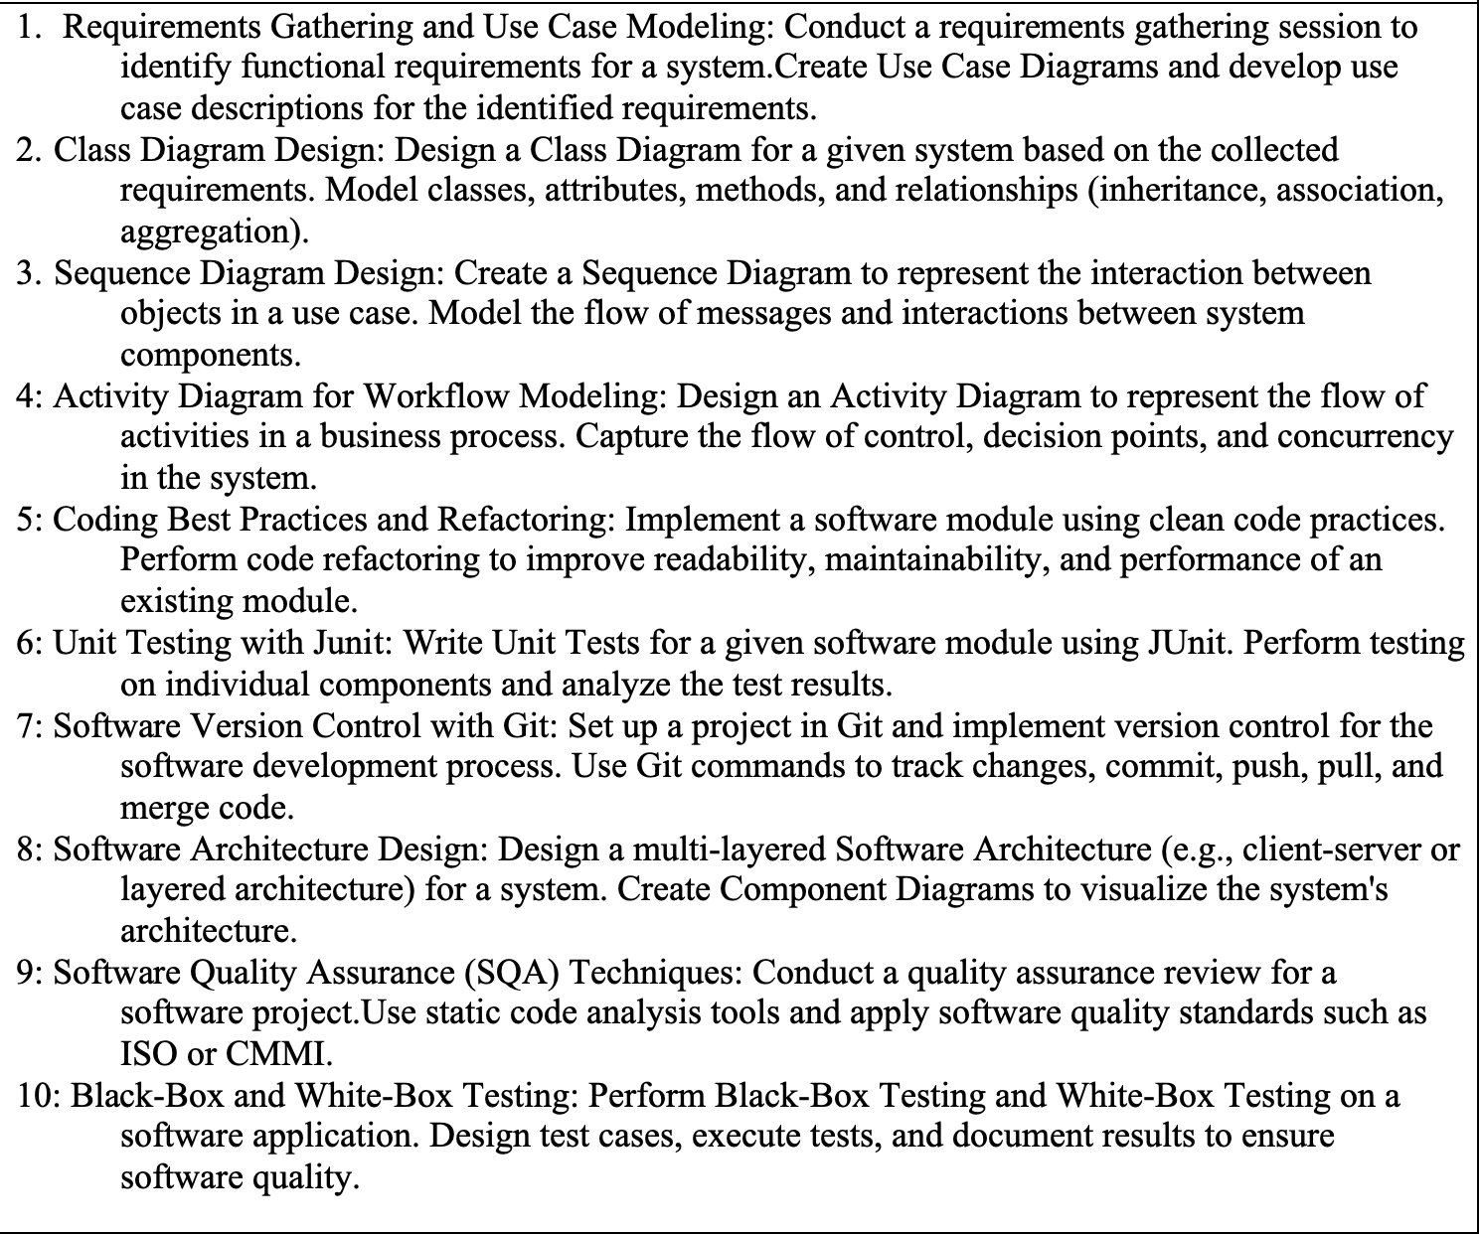
Lab

Slide 8
Evaluation System
InternalEvaluation | Weight | Marks | ExternalEvaluation | Marks
Theory |  | 30 | Semester-Endexamination | 50
Attendance&ClassParticipation | 10%
Assignments | 20%
Presentations/Quizzes | 10%
InternalAssessment | 60%
Practical |  | 20
Attendance&ClassParticipation | 10%
LabReport/ProjectReport | 20%
PracticalExam/ProjectWork | 40%
Viva | 30%
Total Internal |  | 50
FullMarks: 50 +50 = 100

Slide 9
THANK YOU

